Slide 1
Federal Highway Administration Engineering & Software Consultants Inc.
NDE-SHM Integration Project Updates
F.L. Moon, J. Braley, N. Gucunski
August 6, 2019

Slide 2
Summary of Proposed Integration Strategies
SHM = Demands
NDE = Capacity
SHM+NDE (damage functions) = Demands
NDE = Capacity
Type of Data
Model Resolution
Element-level = Demand
Fiber Model = Capacity
Refined Shell = Demand
Fiber Model = Capacity
Element-level = Demand
Fiber Model = Capacity
Refined Shell = Demand
Fiber Model = Capacity
Model Updating
LHS + Error = Capacity
LHS = Demand
LHS/MCMC + Bayes = Capacity
LHS = Demand
LHS + Error = Capacity
LHS = Demand
LHS/MCMC + Bayes = Capacity
LHS = Demand
LHS + Error = Capacity
LHS = Demand
LHS/MCMC + Bayes = Capacity
LHS = Demand
LHS + Error = Capacity
LHS = Demand
LHS/MCMC + Bayes = Capacity
LHS = Demand
IS1
IS2
IS3
IS4
IS5
IS6
IS7
IS8
Control: SHM, Element-level, LHS +Error

Slide 3
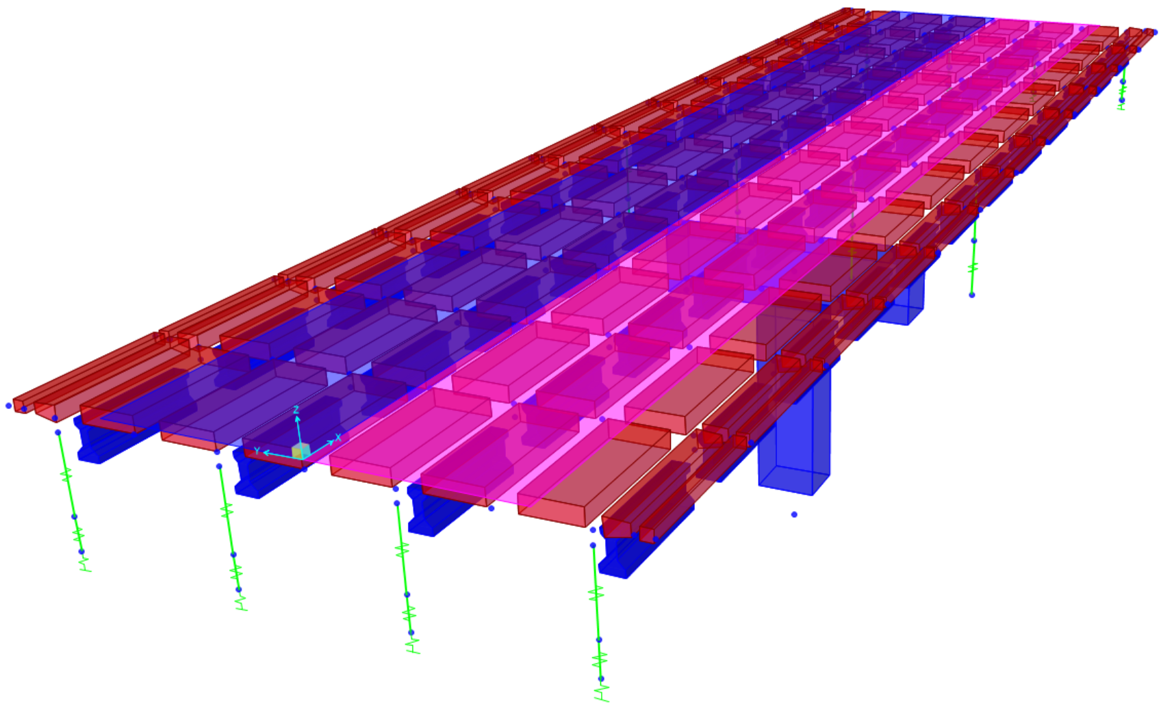
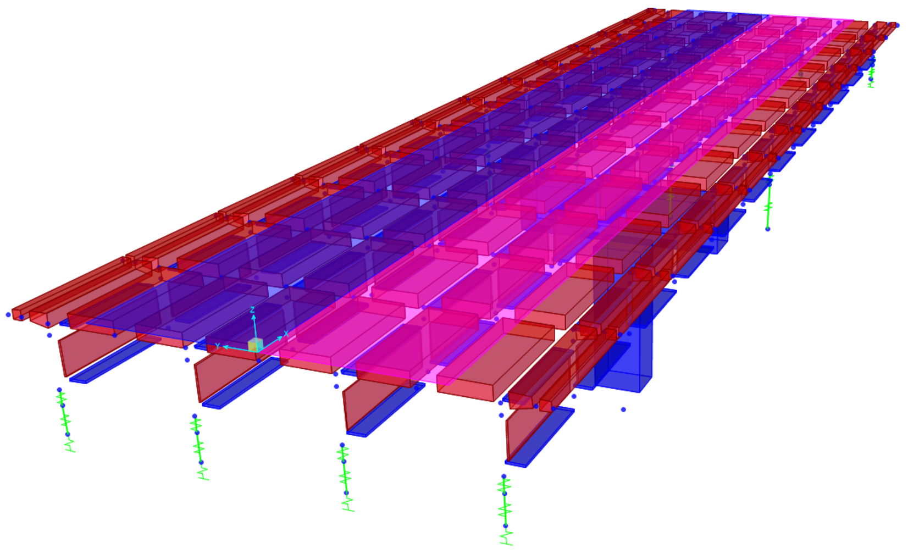
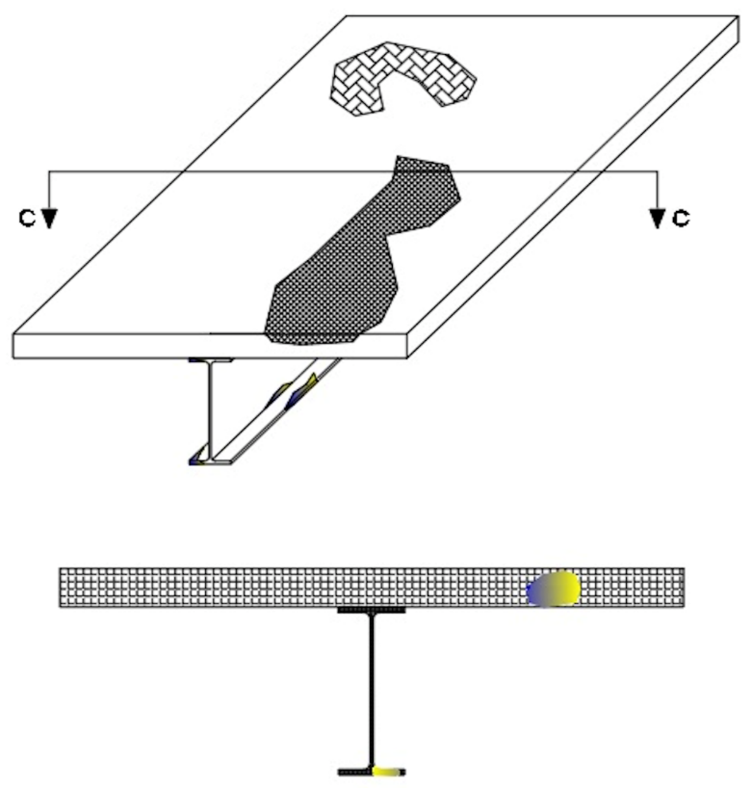
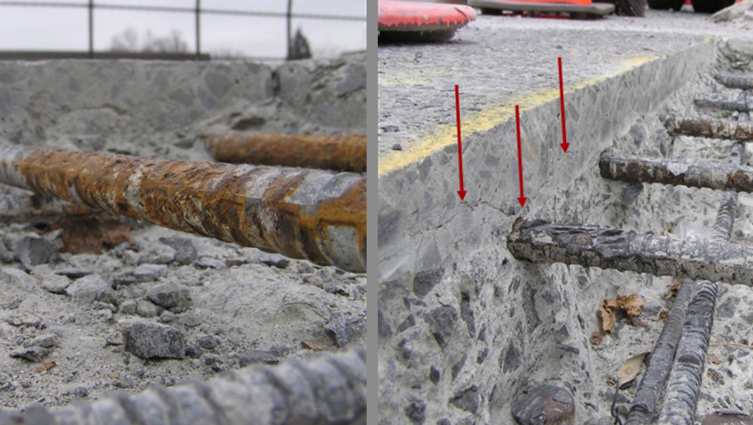
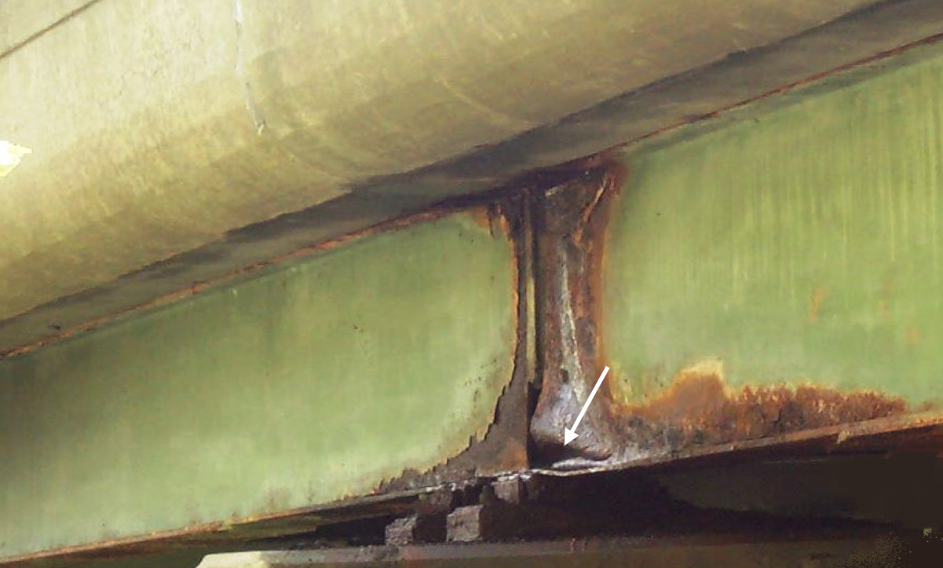
Task 2.1. Numerical Simulation (Sensitivity Analysis)
Influence of Local Deterioration on Structural Demands
Influence of Deterioration on Structural Capacity

Slide 4
Overview of Capacity Estimation
Goal: Estimate the influence of specific defects (e.g. delaminations, prestressed tendon loss, loss of composite action) on flexural behavior
Ultimate Moment Capacity – moment associated with the failure criteria provided by the AASHTO LRFD (generally governed by a maximum concrete compression strain)
Ductility – the nonlinear deformation capacity of the cross-section (generally reported in terms of a ratio of yield curvature to ultimate curvature)

Slide 5
Overview of Fiber Model
Advantages – simply yet robust model capable of simulating the nonlinear flexural behavior (both force and deformation) of general cross-sections composed of multiple materials
Disadvantages – requires the use of an assumed strain profile and cannot directly simulate 3D behaviors
Model Overview…
ε
σ
Element i
ε_{i,j}
σ_{i,j}
ε_{i,j} = φ_{j} (d_{i} – NA_{j})
σ_{i,j} = f(ε_{i,j}) (nonlinear material model)
P_{j} = Σ σ_{i,j} A_{i} = 0 (constraint)
NA_{j}
M_{j} = Σ σ_{i,j} A_{i} d_{i}
d_{i}
NA_{j}
φ_{j}

Slide 6
Software Implementation (MATLAB)
User Input
Software Translation
Optimization (solve for Na_{j} to satisfy ΣF_{j} = 0)
Structural Parameters
Defect Definition
Preprocessing
Moment Curvature

Slide 7
User Input
Assign global bridge geometry
Span length
Girder spacing
Assign deck properties
Deck thickness
Rebar size and spacing
Specify material properties
Stress-strain relationship
Density
Automated Girder Sizing
AASHTO LRFD specifications
Steel Multi-girder Bridges
Select wide flange or built-up girder
Prestressed Concrete Multi-girder Bridges
Select AASHTO or Bulb-Tee section
Specify diameter and number of prestressing strands

Slide 8
Defect Definition
Delamination or section loss
Specify size, shape, and location of defect
Remove contribution of corresponding fibers (i.e. stress=0)
Loss of composite action
Specify elevation where strain is discontinuous (i.e. shear release)
Specify location of N.A. between 1.0 (fully composite) and 0 (non-composite) or percent of deck capacity that can be developed
Loss of prestressing strands
Specify the location and number of broken prestressing strands
Remove contribution of corresponding fiber to stiffness and prestressing

Slide 9
Preprocessing
Perform automated girder sizing as per AASHTO LRFD
Compute initial demands
Steel: dead load
Prestressed: dead load and prestressing force (including losses)
Compute initial strain and curvature
Mesh cross-section into “fibers” and assign the corresponding material model and properties

Slide 10
Computation of Moment from Curvature
Curvature is specified
Strain in each fiber is computed (based on curvature and N.A.)
Stress in each fiber is computed using material constitutive relations
Forces are computed and summed
If ΣF≠0, adjust N.A.
If ΣF=0, compute sum of fiber moments about section centroid
Incrementally increase curvature until a failure criterion specified by AAHSTO LRFD is reached
Optimization Algorithm

Slide 11
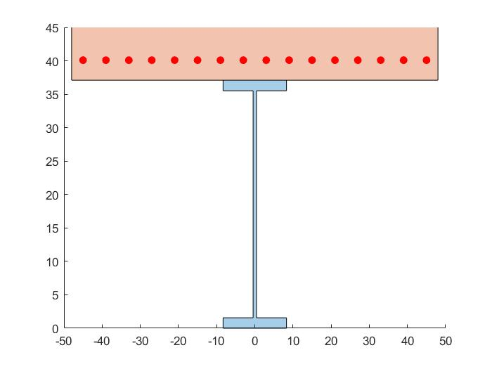
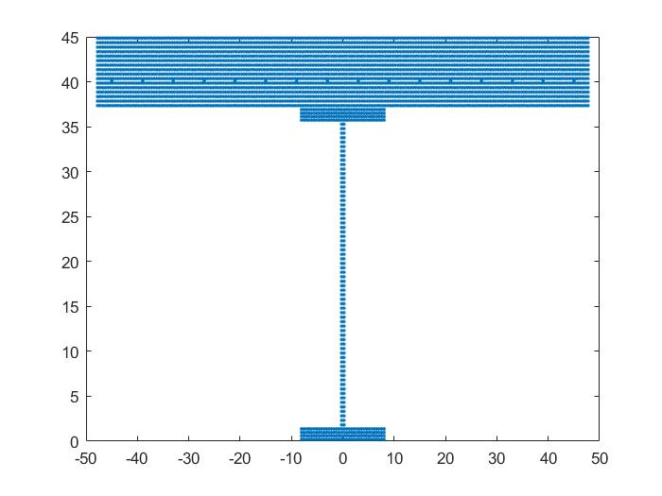
Demonstration
Girder cross section
Meshed cross section
50ft. Span length
8ft. Girder spacing
Girder: W36X282
8in. Deck w/ #6 rebar @ 6in.
Steel Material: Elasto-plastic
Concrete Material: Hognestad Model
Defect: Full-width delamination of varying depth
Assume concrete crushing at strain = 0.0038

Slide 12
Influence on Rating Factor
Factored Capacity –
Factored DL, SDL
Rating Factor =
Factored LL
Assumptions:
Nominal rating factor of the bridge is 1.5
Deterioration does not influence DL force effects

Slide 13
Next Steps for Capacity Estimation
Perform parametric studies to quantify the level of deterioration and bridge-specific characteristics that should be examined for the NDE-SHM integration strategies
Key bridge parameters include:
Span length (50-150 ft.)
Girder spacing (6 – 12 ft.)
Bridge Type (Steel multi-girder, PS Concrete multi-girder)
Key defect parameters
Delamination depth (2 – 4 in.)
Loss of composite action (0 – 100%)
Loss of prestressing strands (1-3 strands)

Slide 14
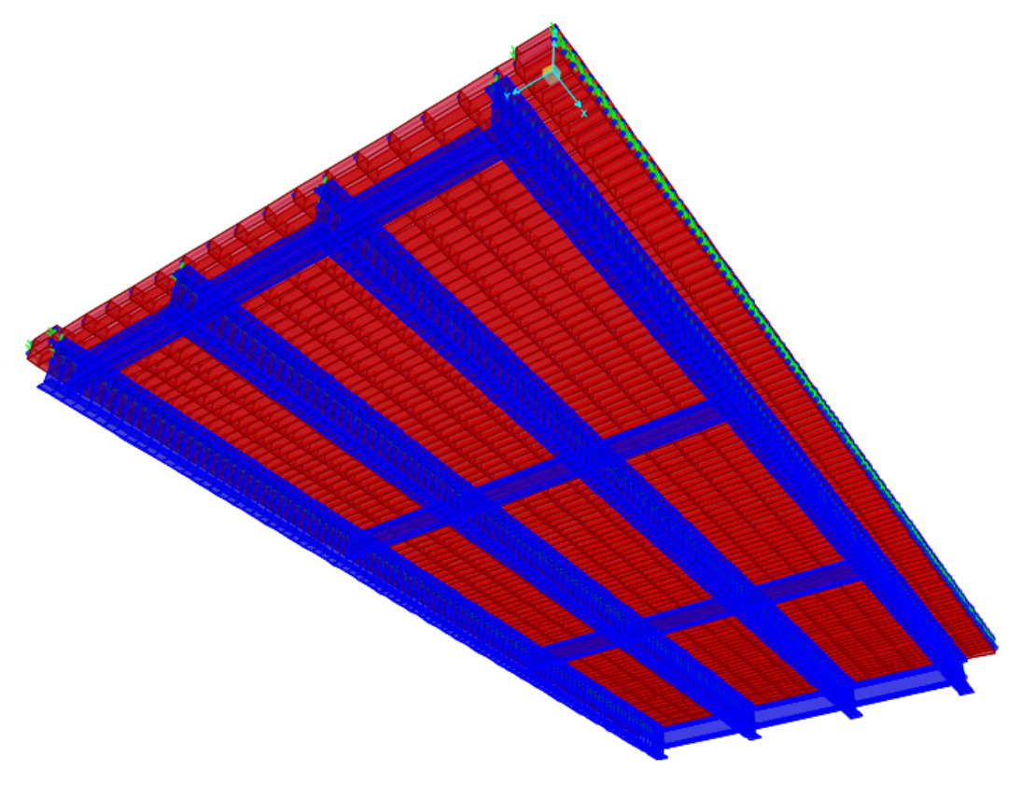
Next Steps for Demand Estimation
Loss of composite action at girder ends and mid-span
Develop and error screen FE models
Multi-girder steel and multi-girder PS concrete bridges
100 ft. span length
8 ft. girder spacing
6 girders
Simulate the same defects examined for capacity estimation (delamination, loss of composite action, loss of prestressing strands)
Quantify the influence of the defects on element-level demands
Loss of prestressing strands at mid-span
Delaminations at mid-span center and edge

Slide 15
Revised Schedule
 | Month
Tasks | July | August | September | October | November | December
Build and Error Screen Fiber Model (Steel Beam)
Build and Error Screen Fiber Model (Prestressed Concrete)
Build FE model of steel multigirder bridge
Build FE model of prestressed bridge
Perform sensitivity studies with fiber models (moment curvature)
Deck delamination
Localized reduced modulus
Loss of composite action
PS strand loss
Process and interpret data
Perform sensitivity studies with FE models (load distribution)
Deck delamination
Localized reduced modulus
Loss of composite action
PS strand loss
Process and interpret data
Evaluate effect of degredation on load ratings
Select case structures with appropriate field data
Incorporate field data into demand models
Incorporate field data into capacity models
Process and intepret data
Report on findings
Completed

Slide 16
Federal Highway Administration Engineering & Software Consultants Inc.
NDE-SHM Integration Project Updates
F.L. Moon, J. Braley, N. Gucunski
August 6, 2019

